Slide 1
ParkingNow Application (Autoencoder Neural Network)
Ca’Marai Clyburn

Slide 2
Table Of Content
Problem
Storyboard
Goal
Research/ Existing Apps
Experiment
6.Balsmaic Walk
7.App Walk Through
8. University Edition
9. Autoencoder Architecture & Training
10. Autoencoder Training Loss Curve
11. ROC Curve (Rule-Based Anomaly Labels)
12. Precision–Recall Curve (Rule-Based Anomaly Labels)

Slide 3
1. Problem
Finding a parking spot in NYC
Saving time finding a parking spot
Finding a parking spot that is not too far from the targeted location
Paying the meter easily
Being able to extend meter time if need be

Slide 4
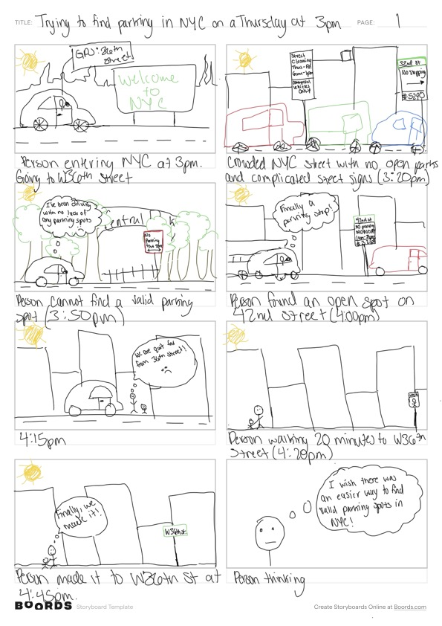
2. Storyboard
Key user groups: licensed drivers, NYC visitors, and residence
Goals: Fast and accurately find parking in NYC
Frustrations: Finding a parking spot that is not at risk of towing or ticketing

Slide 5
3. Goal
Create an app that limits drivers' time spent finding a parking spot
Make meter payment more accessible(by smartphones/tablets)
Notifies when the meter is almost up; option to extend the time

Slide 6
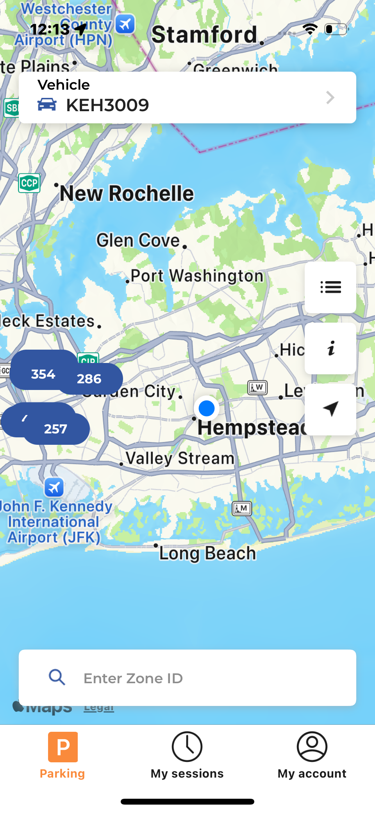
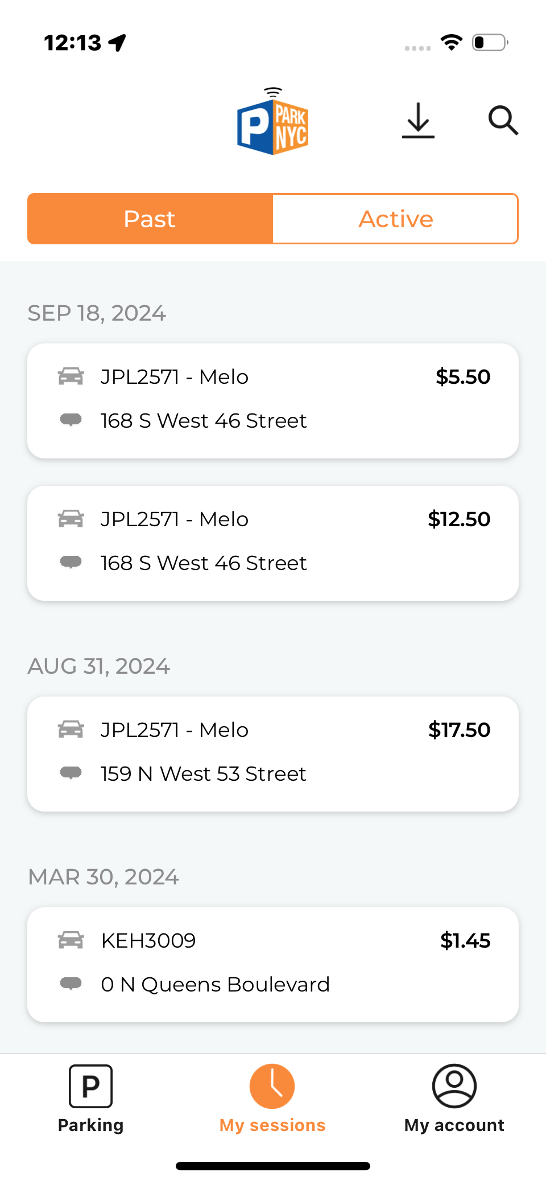
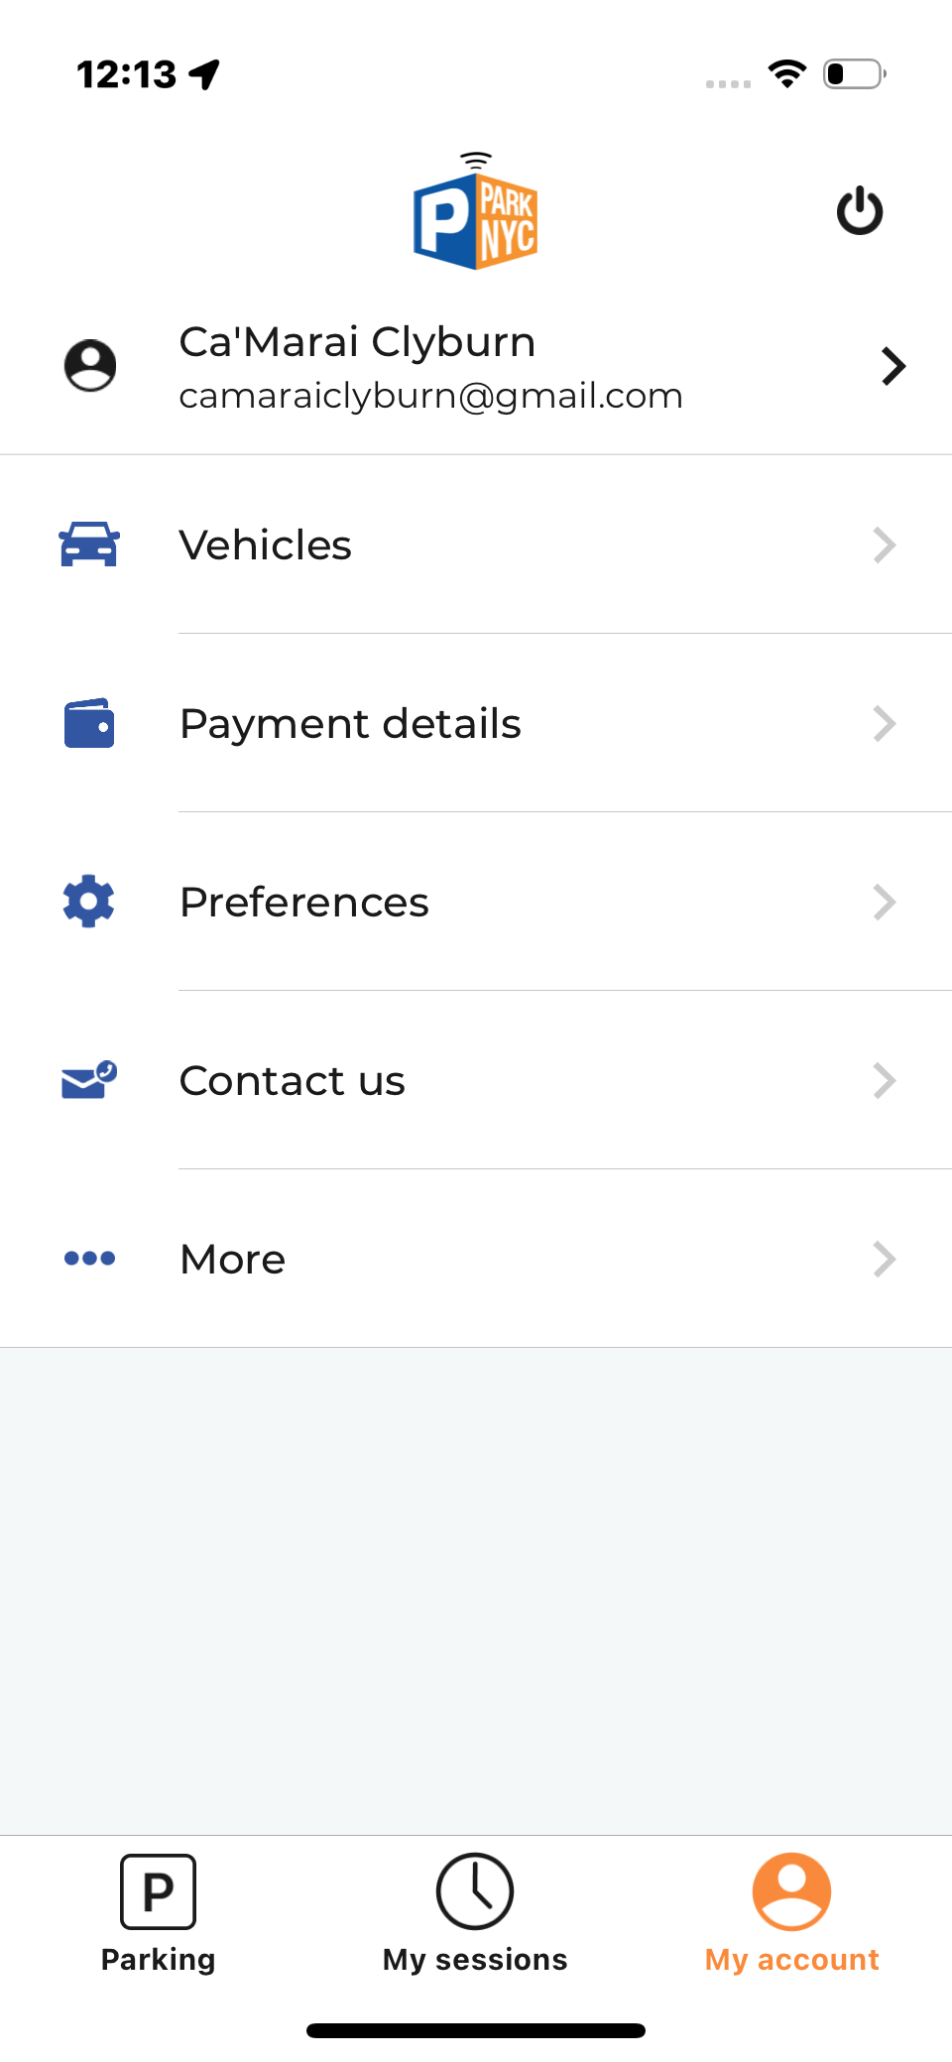
ParkNYC Application
4. Research/ Existing Apps
The goal of this application is to pay for parking

Slide 7
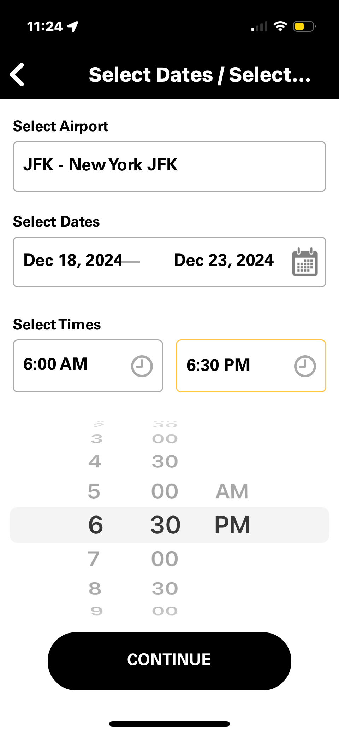
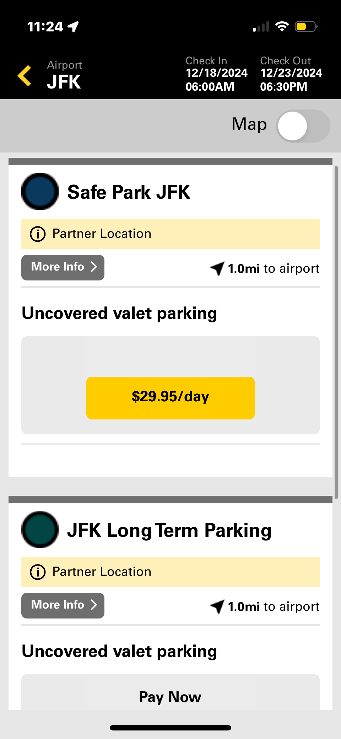
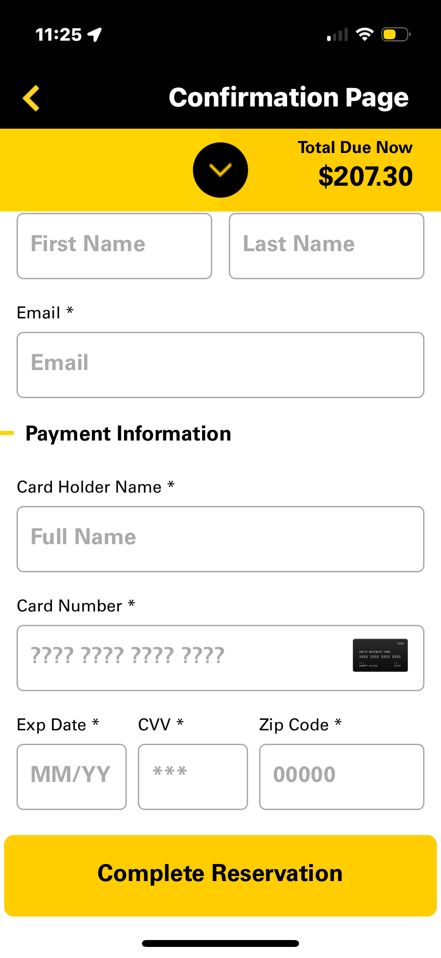
theParkingSpot Application
4. Research/ Existing Apps
The goal of this application is to pay for long-term parking. The app has the user enter the dates and times they will be leaving their car parked and displays the prices per day. The user is also able to pay through the app.

Slide 8
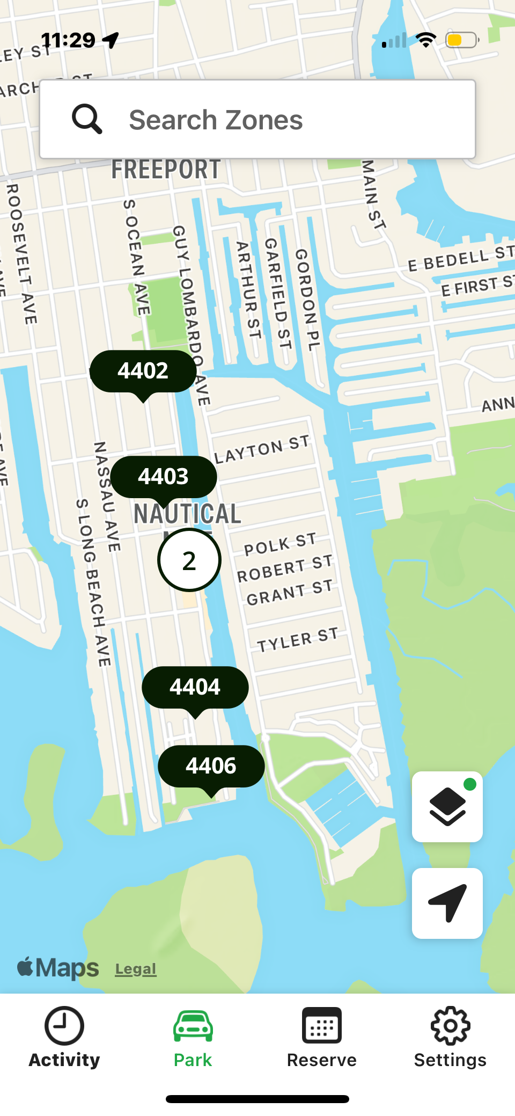
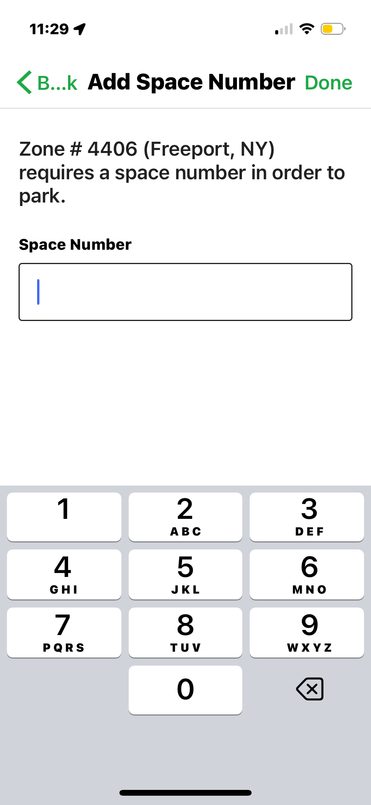
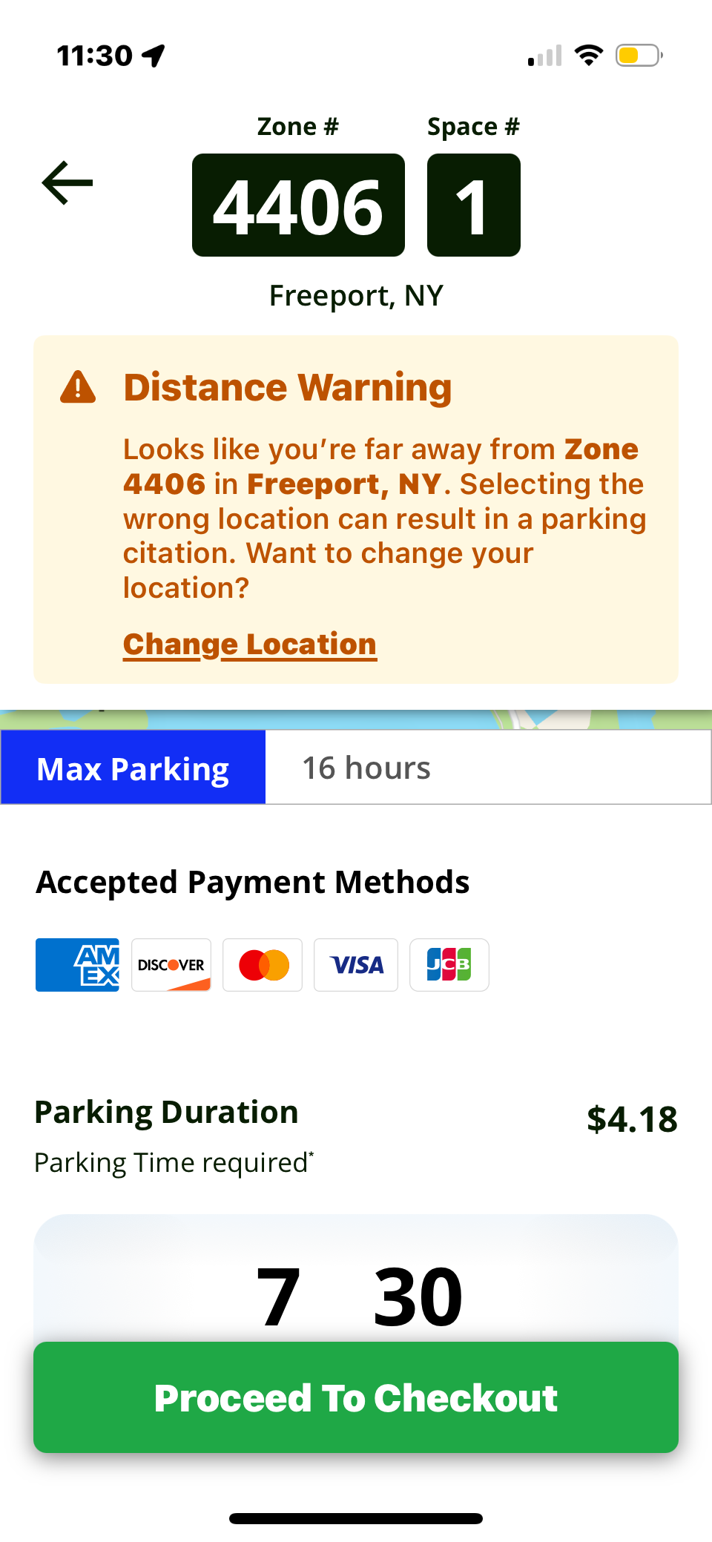
ParkMobile Application
4. Research/ Existing Apps
The goal of this application is to pay for parking. The app utilizes zones to identify parking spot locations. Each spot also has its own space number.

Slide 9
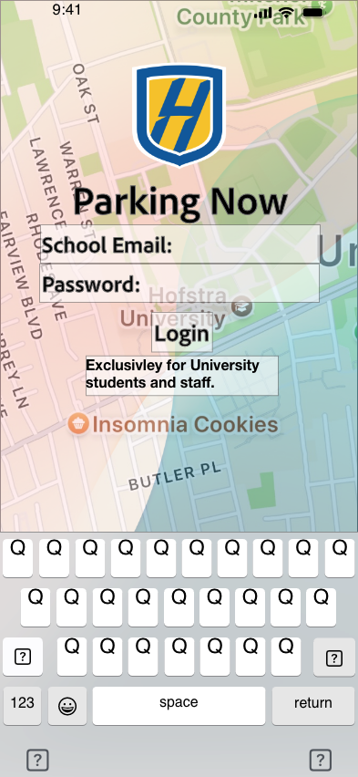
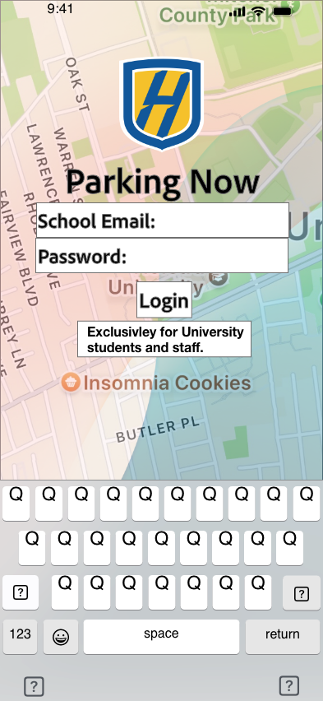
Parking Now Application
5. Experiment
Task: Find a parking spot
Filling in the white areas completely
Easier to find
Resulted in faster task completion times
Before
After

Slide 10
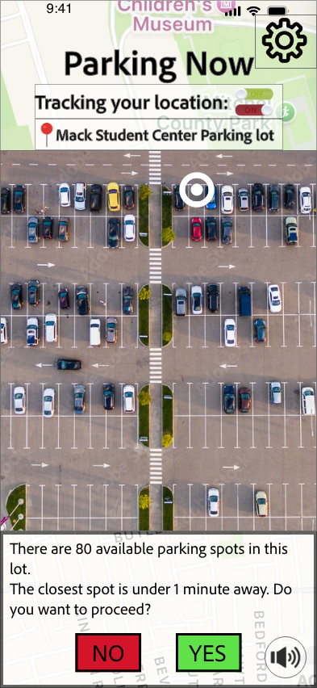
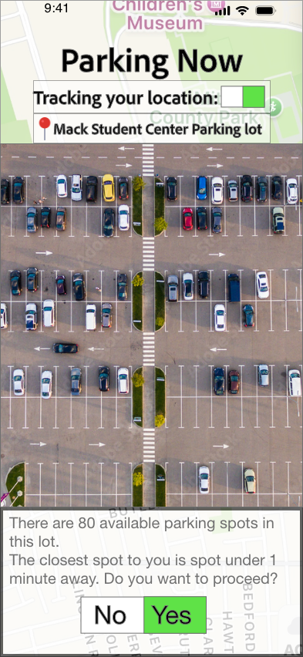
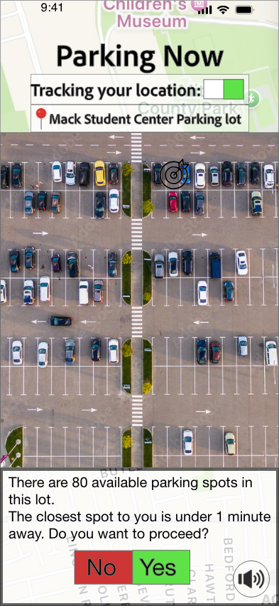

Parking Now Application
5. Experiment
Task: Find a parking spot
Changing the color in the “no” button
Made the button easier to read
Changing the targeted park from black to white
Moving the ”yes and “no” buttons further from each other
Prevents the user from clicking the wrong option by accident
Resulted in faster task completion times
Before
After

Slide 11
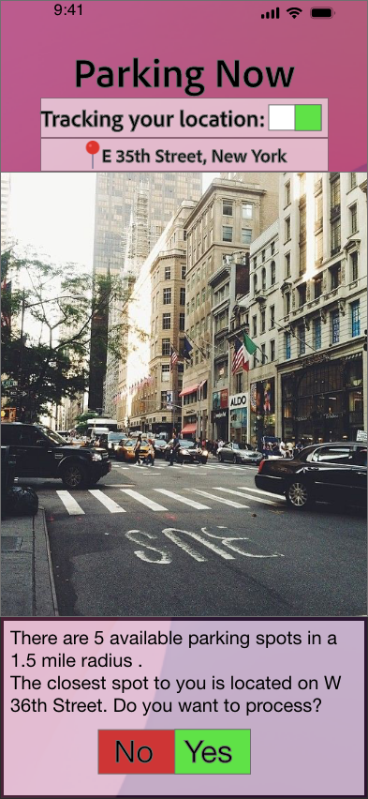
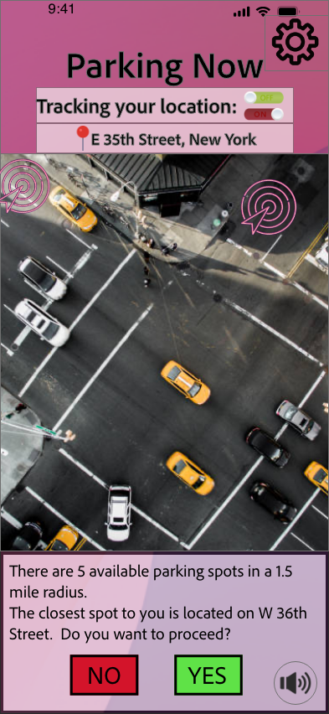

Parking Now Application
5. Experiment
Task: Find a parking spot and pay the meter time
Changing the slider bar
Easier to find
Changing the view from street to aerial
Moving the ”yes and “no” buttons further from each other
Prevents the user from clicking the wrong option by accident
Resulted in faster task completion times
Before
After

Slide 12
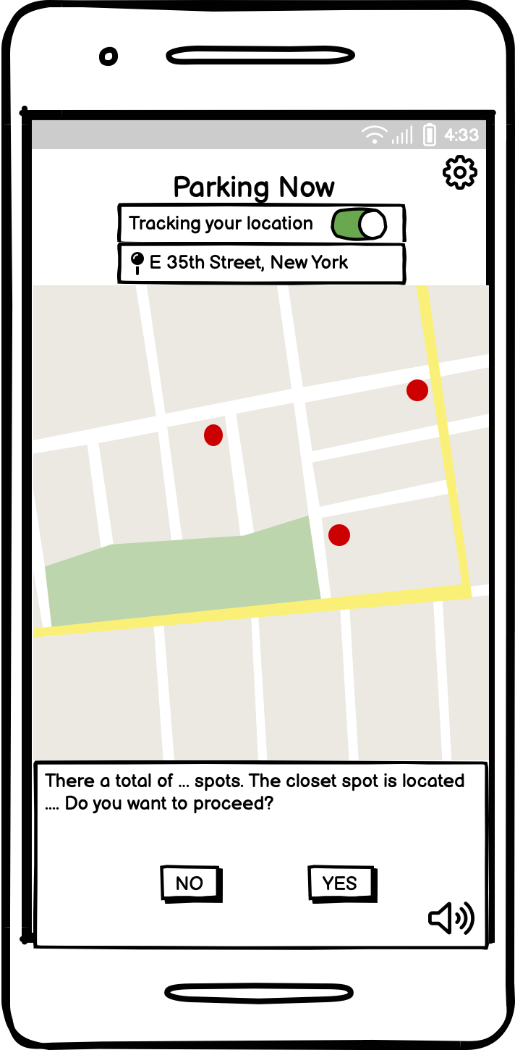
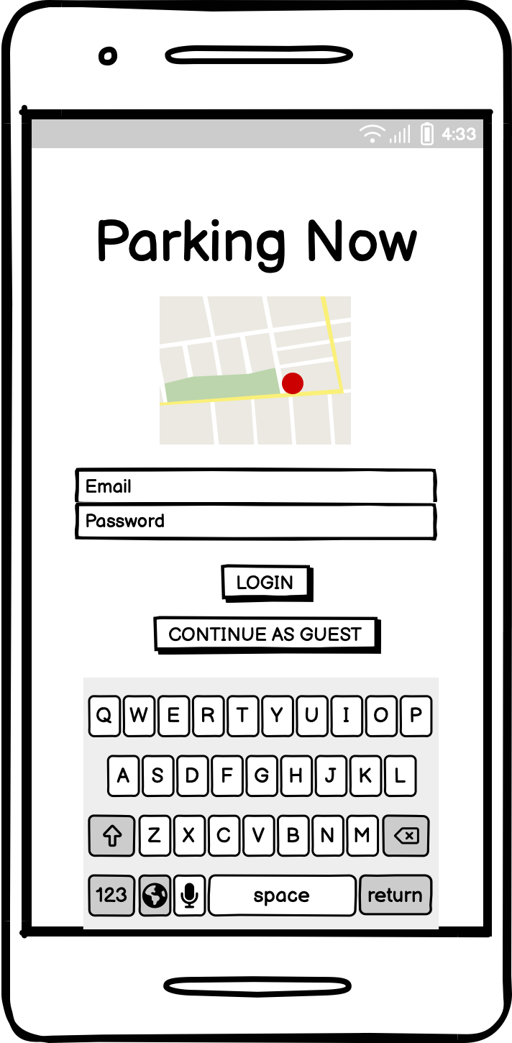
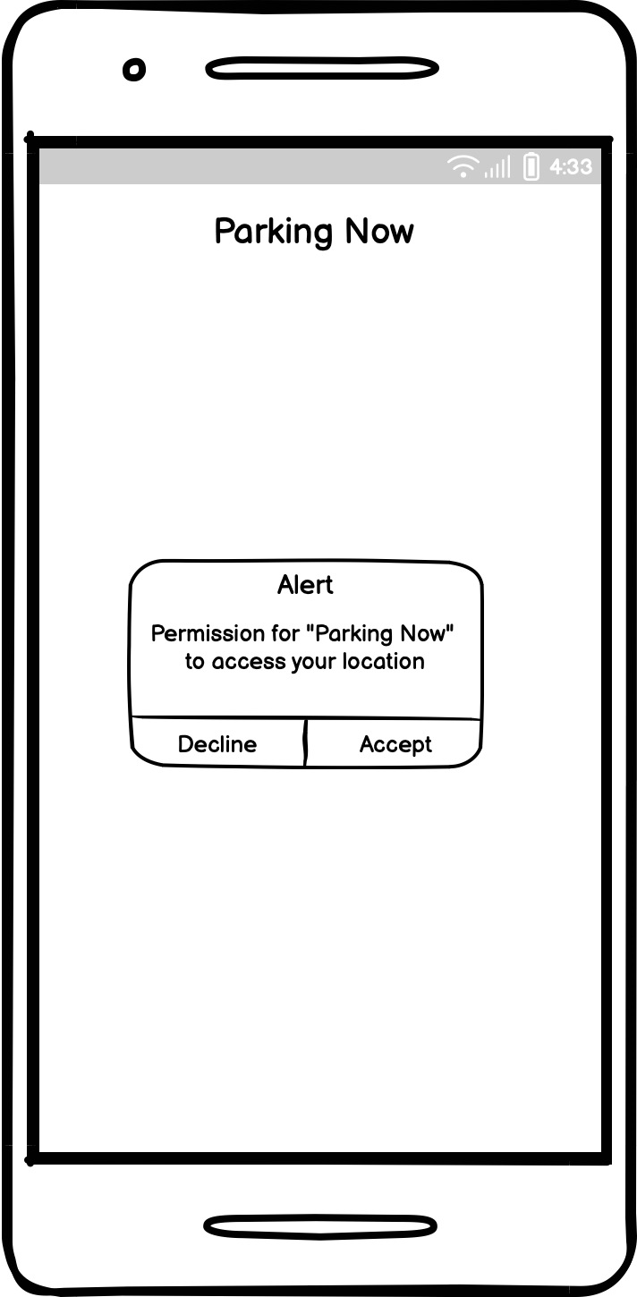
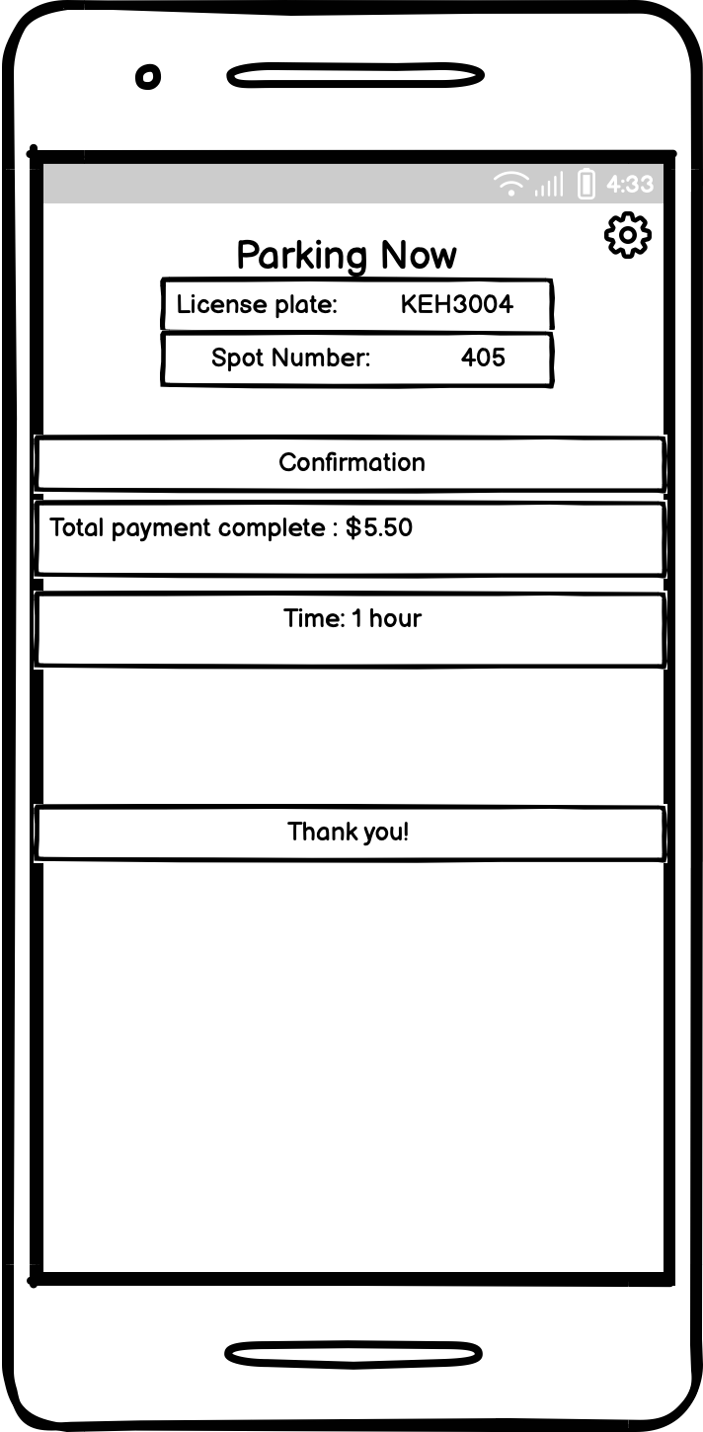
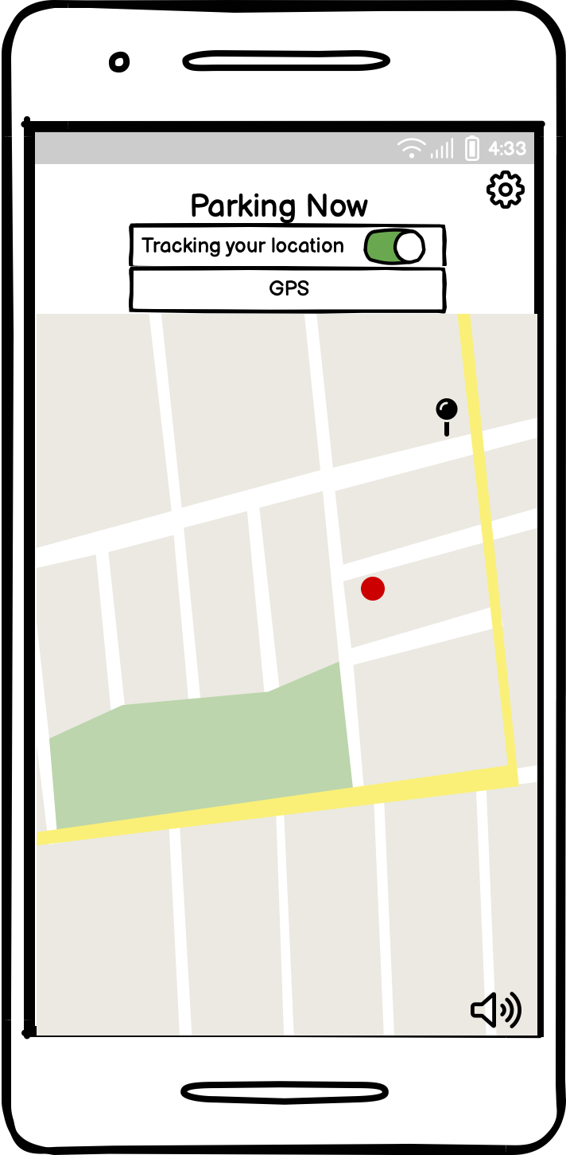
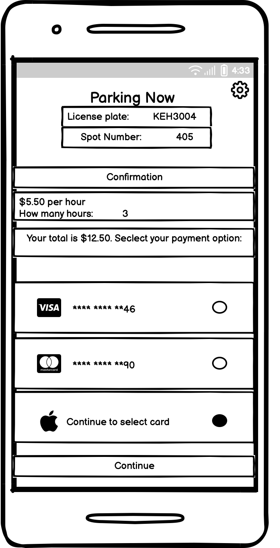
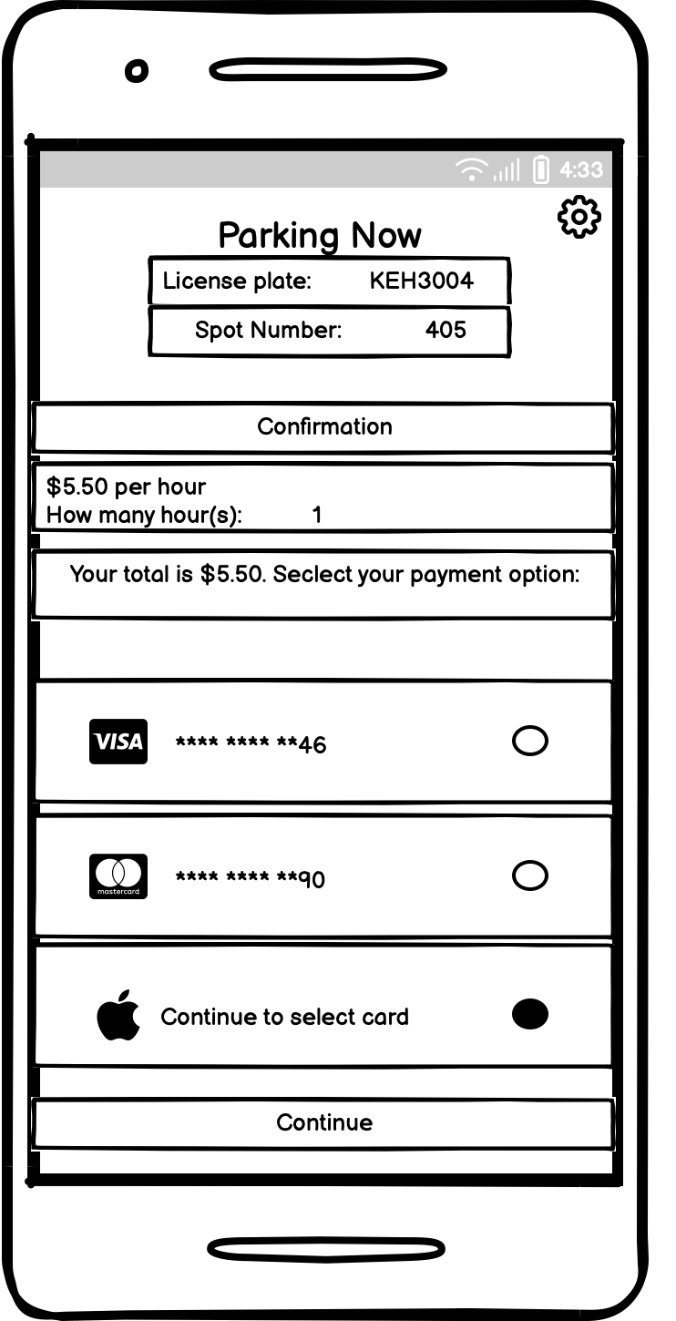
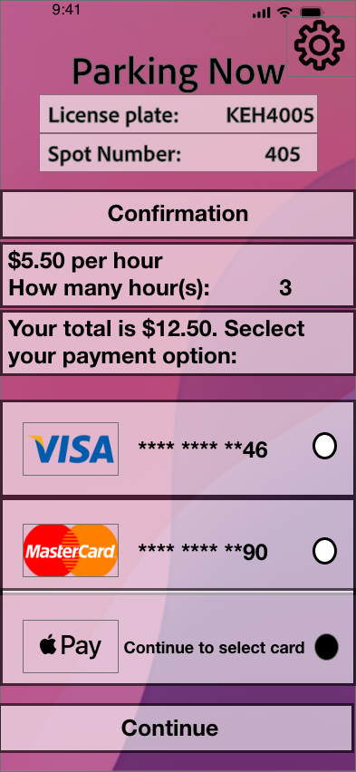
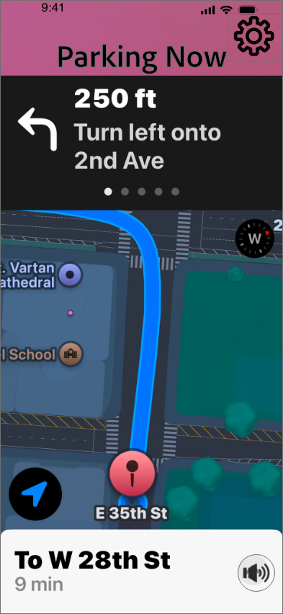
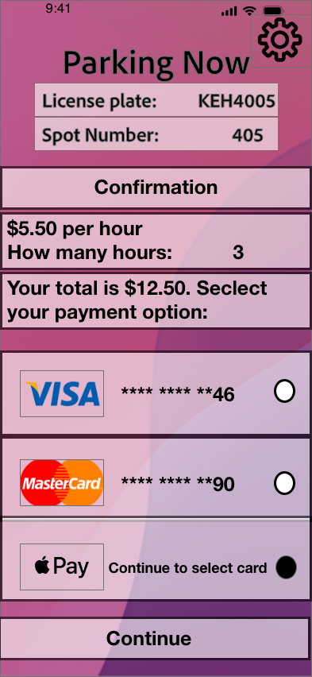
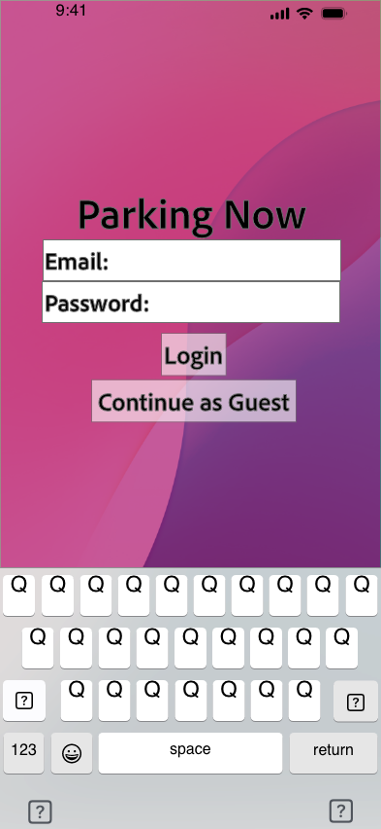
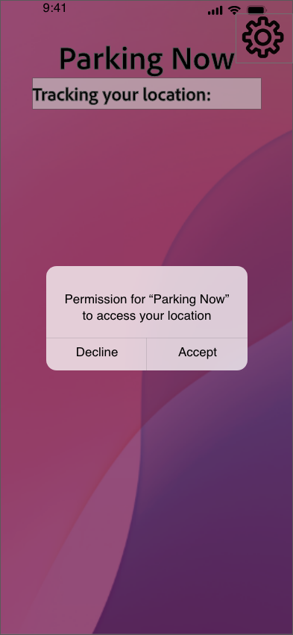

6. Balsmaic Walk Through

Slide 13
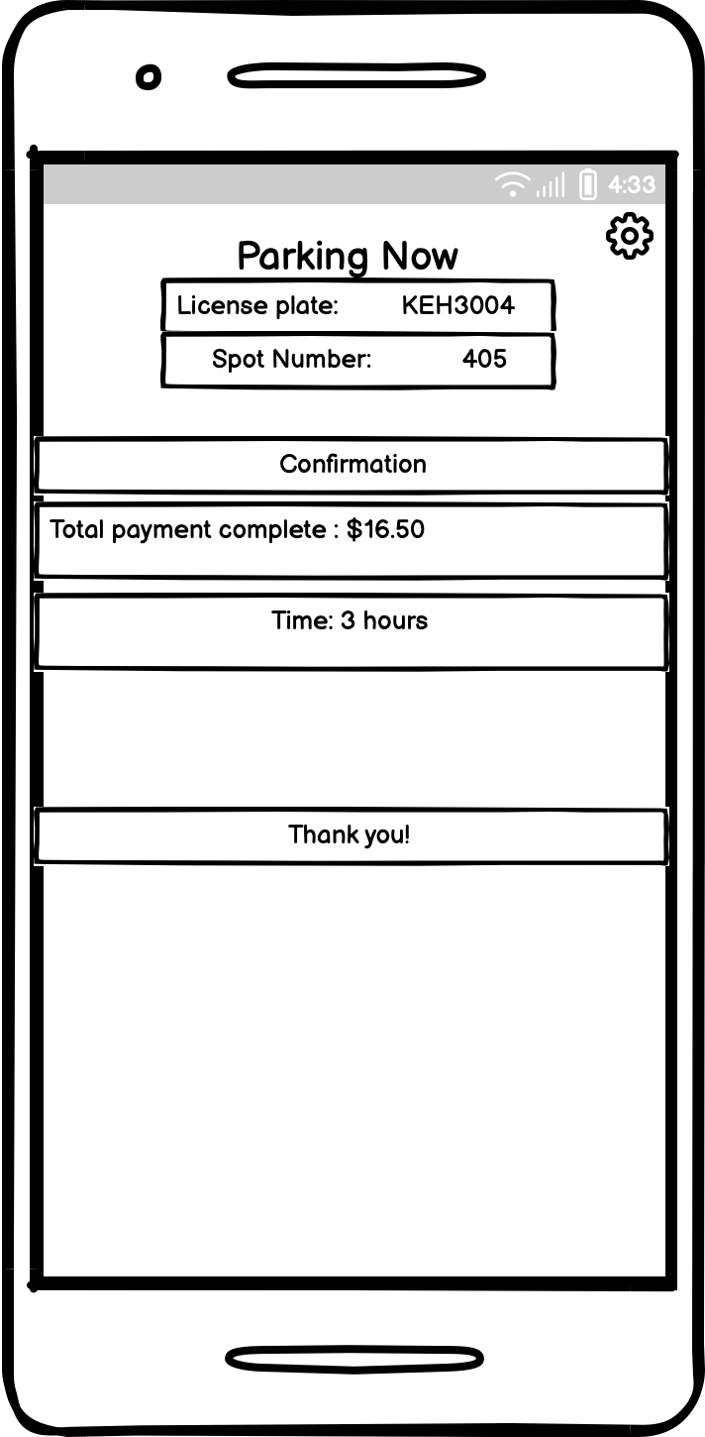
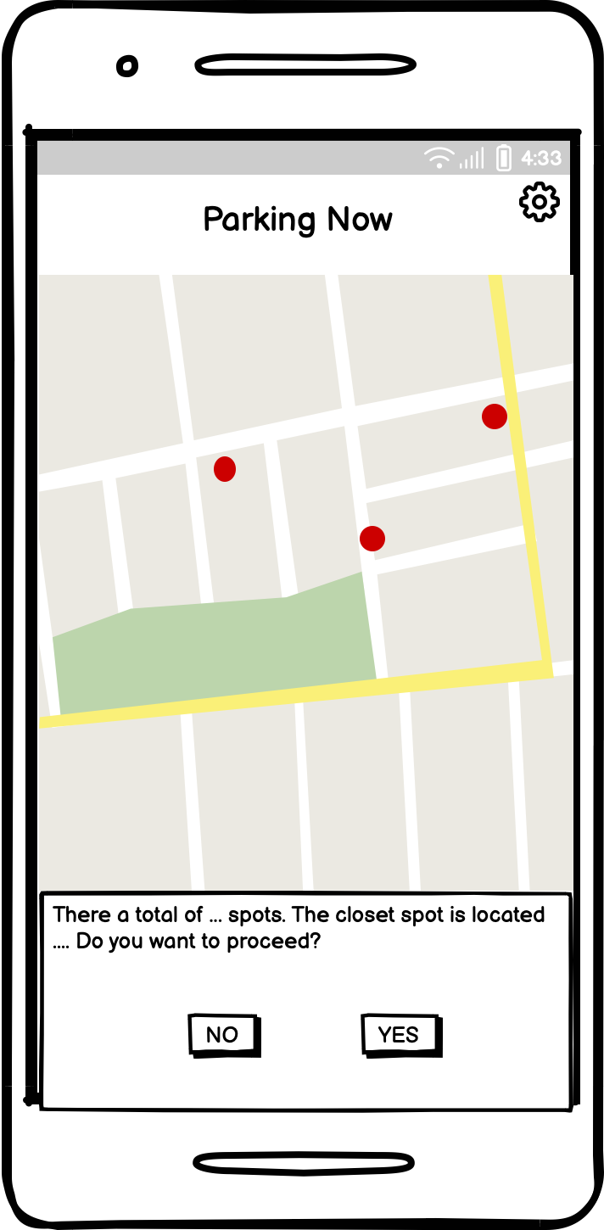
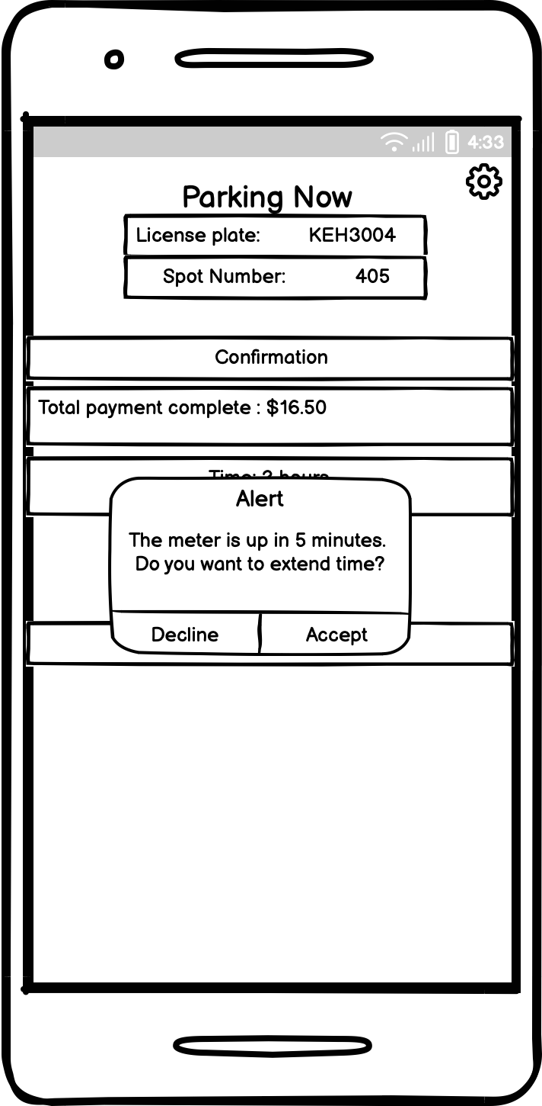

6. Balsmaic Walk Through

Slide 14
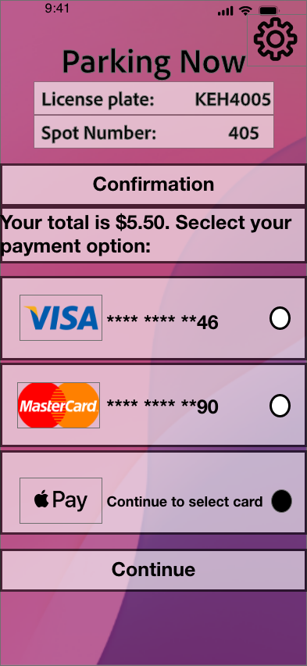

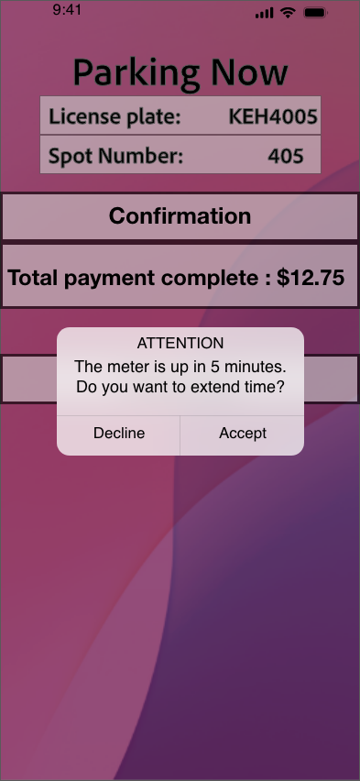
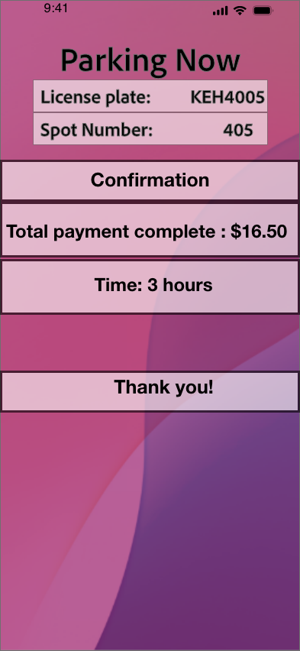

7. City Edition Walk Through

Slide 15
7. City Edition Walk Through

Slide 16

7. City Edition Walk Through

Slide 17
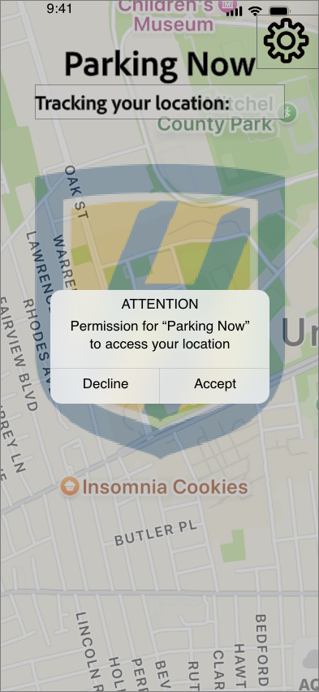
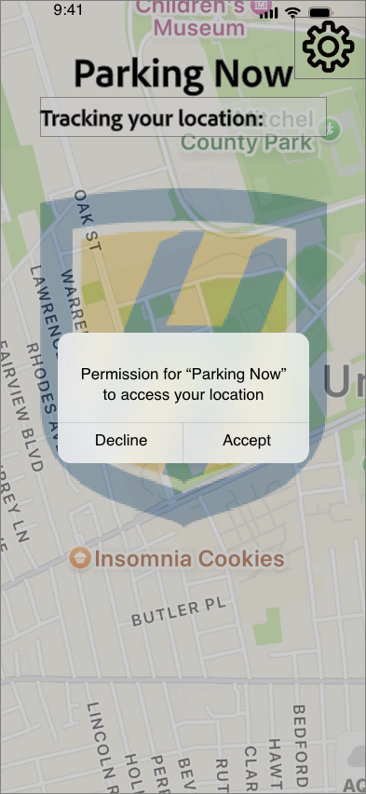
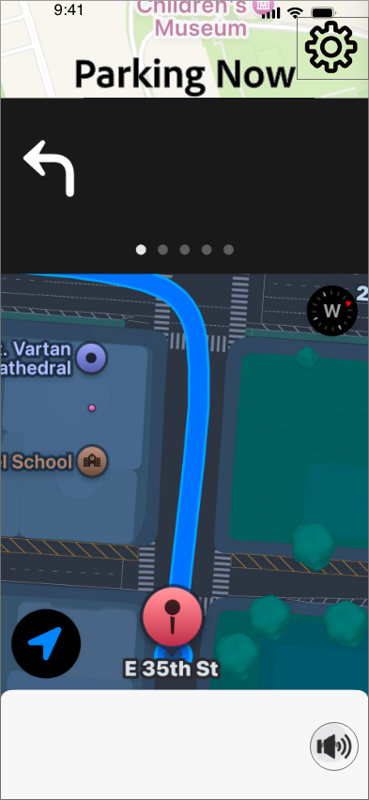
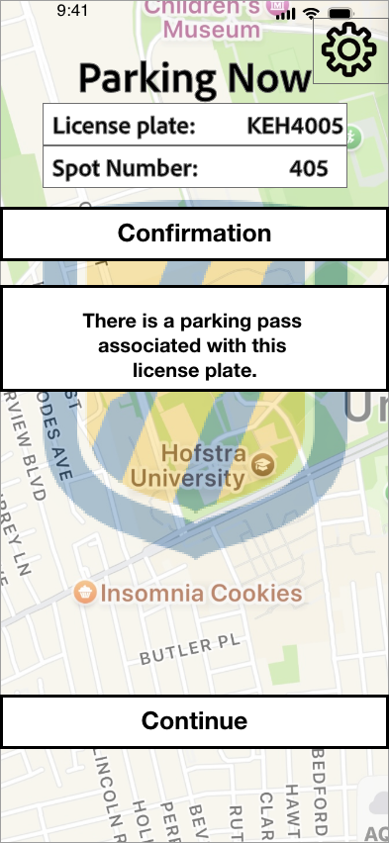
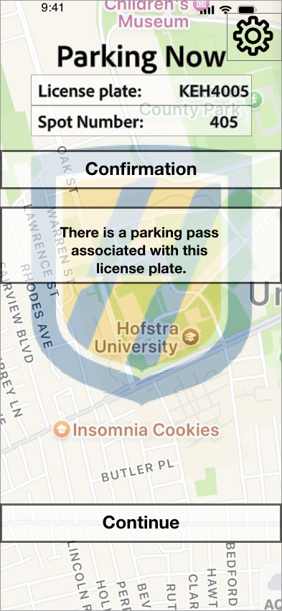
8. University Edition Walk Through

Slide 18
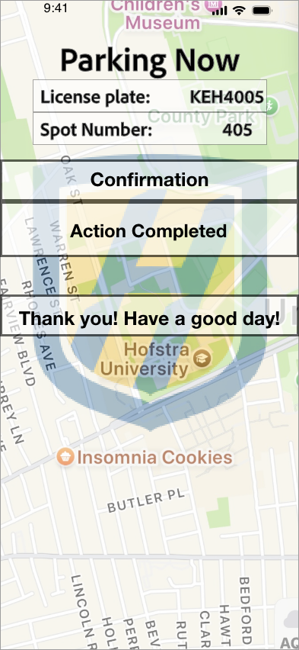
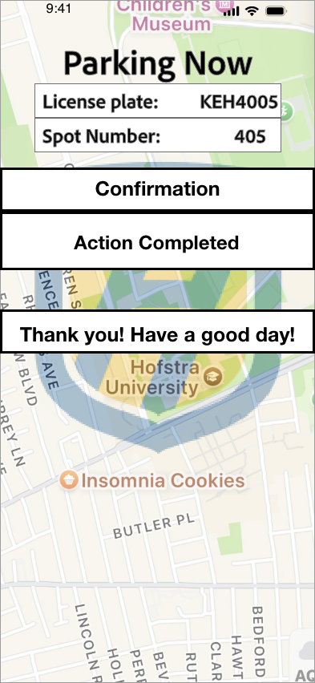
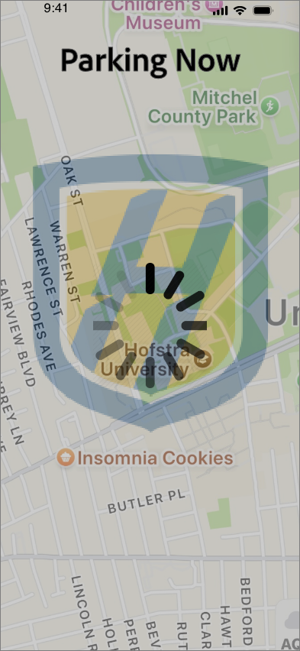
8. University Edition Walk Through
Differences:
Main goal is to find an available parking spot
Electronic way for university police to monitor parking
Payment is not necessary; linked to parking pass through the university

Slide 19
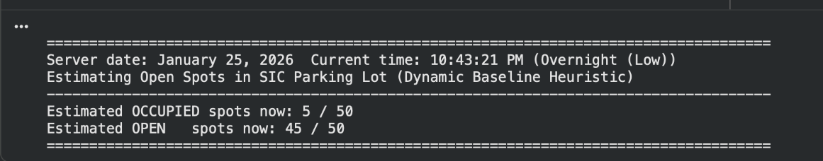
9. Autoencoder Architecture & Training
Input Layer: 8 features
Encoder:
Hidden Layer 1: 32 units (ReLU activation)
Latent Space: 16 units
Decoder:
Hidden Layer: 8 units
Output Layer: 8 reconstructed features
Loss Function: Mean Squared Error (MSE)
Optimizer: Adam (learning rate = 0.001)
Activation Function: ReLU between layers
Regularization: Dropout layers included but set to 0.0 due to small dataset size
Training Process:
Mini-batch training
Reconstruction loss computed per batch
Backpropagation used to update weights until convergence

Slide 20
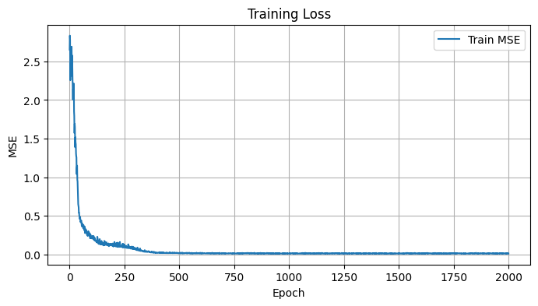
10. Autoencoder Training Loss Curve
•Displays Mean Squared Error (MSE) across 2,000 training epochs
•Rapid loss reduction during early epochs indicates efficient learning
•Smooth convergence toward near-zero loss shows stable training behavior
•No signs of oscillation or divergence, suggesting appropriate learning rate
•Low final reconstruction error is expected given the low-dimensional dataset
•Confirms that the autoencoder successfully learned dominant patterns in the data

Slide 21
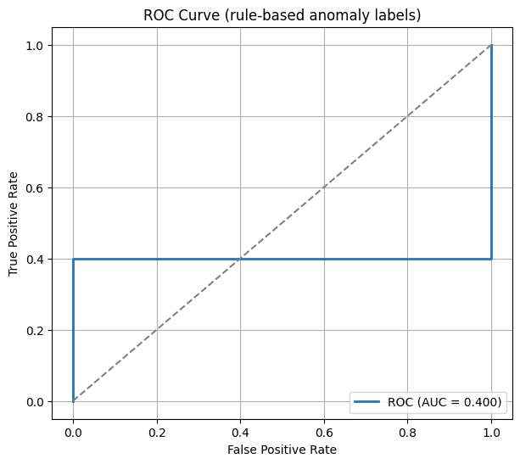
11. ROC Curve (Rule-Based Anomaly Labels)
Evaluates alignment between reconstruction error and rule-based anomaly labels
Observed ROC AUC ≈ 0.40, indicating weak separability
Performance reflects the unsupervised nature of the autoencoder
Rule-based labels capture semantic inconsistencies, not statistical rarity
Low AUC highlights the conceptual mismatch between learned anomalies and logical rules
Demonstrates that reconstruction error alone is not sufficient for semantic classification

Slide 22
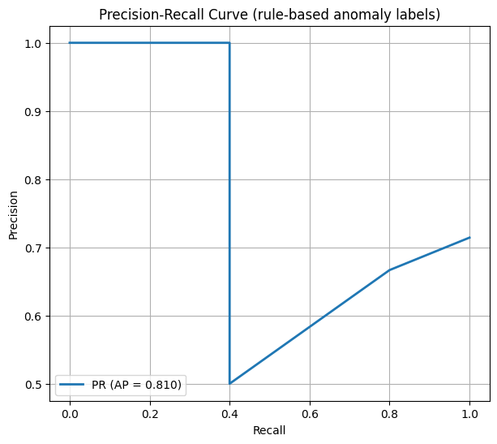
12. Precision–Recall Curve (Rule-Based Anomaly Labels)
Achieved Average Precision (AP) ≈ 0.81, indicating high precision
High precision shows flagged anomalies are usually meaningful inconsistencies
Conservative detection behavior prioritizes correctness over coverage
Lower recall reflects missed anomalies that are not statistically rare
Precision–Recall is more informative than ROC under class imbalance
Supports the use of the model as a screening and quality-control tool

